Slide 1
Generative Modeling by Estimating Gradients of the Data Distribution
Yang Song
Stefano Ermon
Stanford AI Lab
Notes:
This presentation is on generative modeling by estimating gradients of the data distribution, and it is a joint work of Stefano and me at Stanford.

Slide 2
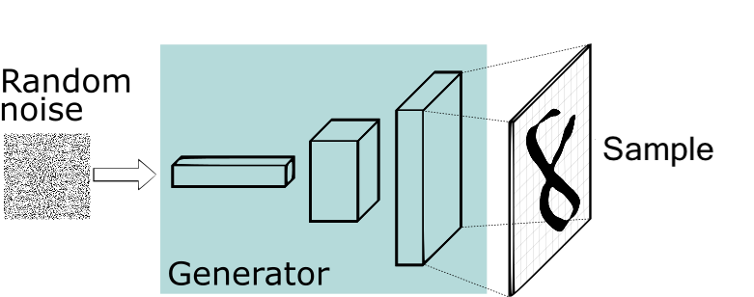
Representations of Probability Distributions
Implicit models: directly represent the sampling process
Cons: hard to train, no likelihood, no principled model comparisons
GAN
Notes:
We can divide existing generative models into two categories based on how they represent probability distributions.
We have implicit models, like generative adversarial networks, where we directly represent a sampling process,
For example, we start with some random noise, we feed it into a transformation, and that produces a sample x. This implicitly defines a distribution over the objects this process can generate.
Implicit models are very commonly used and generally give good samples, but they are hard to train, and there is no likelihood, nor principled way for model comparison.

Slide 3
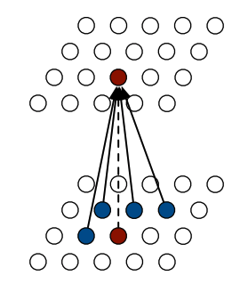
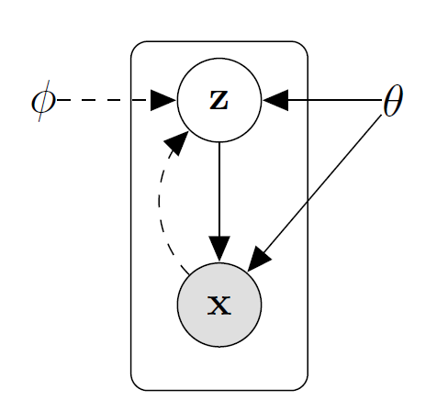
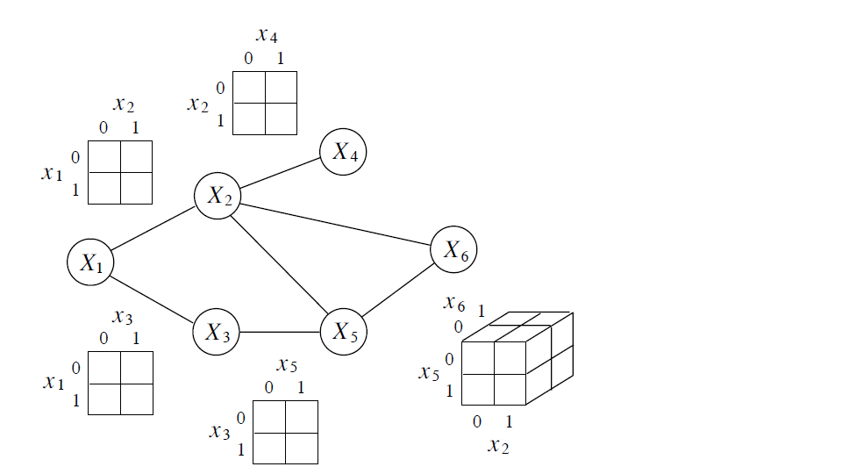
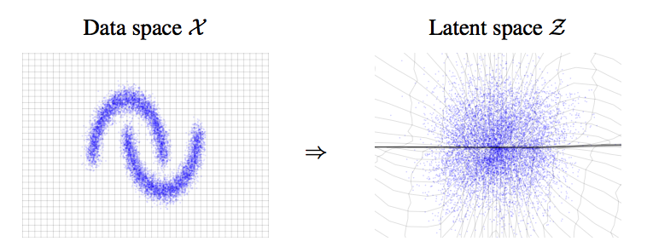
Representations of Probability Distributions
Explicit models: represent a probability density/mass function
Cons: need to be normalized → balance expressivity and tractability
Bayesian networks
(e.g., VAEs)
MRF
Autoregressive
models
Flow models
Notes:
We also have explicit models as the other category of popular generative model, where we represent a probability density or mass function.
We have many popular density models for modeling the probability density function. Here are some examples.
One advantage is that explicit models can be trained by maximum likelihood, and we know how to compare models based on likelihoods.
One limitation is that these models need to be normalized, and there are tradeoffs between tractability, the ability to sample and evaluate likelihoods efficiently, and the flexibility of the distributions that one is able to capture this way.

Slide 4
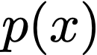
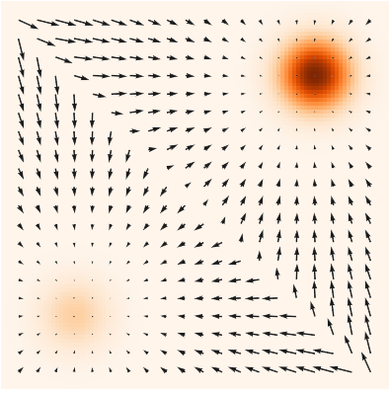
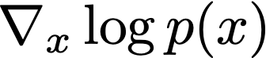
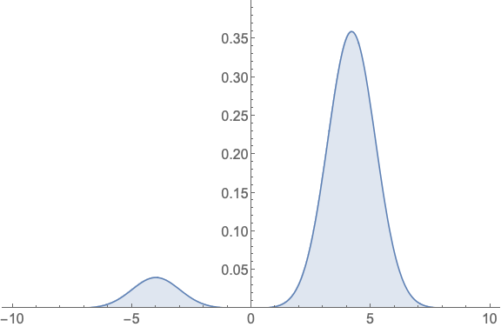
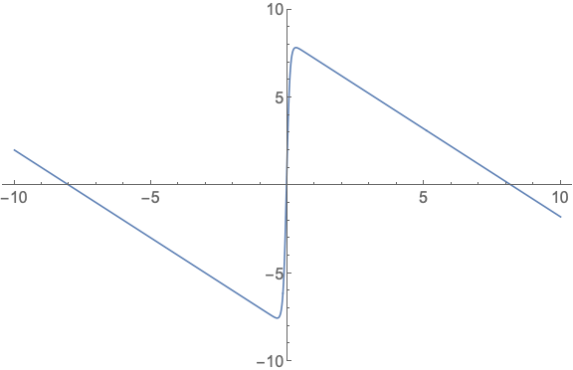
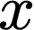
Representation of Probability Distributions
This talk: The gradient of a probability density w.r.t. the input dimensions
Score
NOT the gradient w.r.t. model parameters
(pdf and score)
Notes:
In this talk, I am gonna focus on another way of representing a probability distribution. Notice that when the pdf is differentiable, we can compute its gradient over the random variable. This gradient is widely known as the score function of a probability distribution. Be careful that this is NOT the gradient wrt model parameters.
In the following image, we show scores and density function together for a mixture of Gaussian. The density function is color coded, where darker color means higher probability density. The score is a vector field of gradients that point to directions where probability densities grow most quickly. Both density and score functions are equivalent ways of describing the same probability distribution when the density is differentiable.
However, density functions have to be normalized no matter how you vary the parameterization and model parameters, which limit their flexibility. In constrast, score functions do not have any difficult constraints and are much more flexible to parameterize.

Slide 5
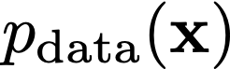
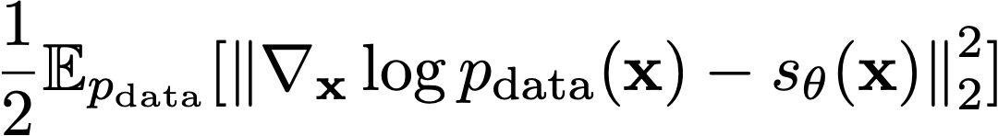
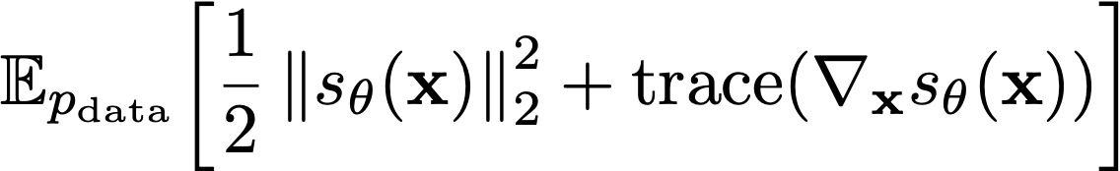
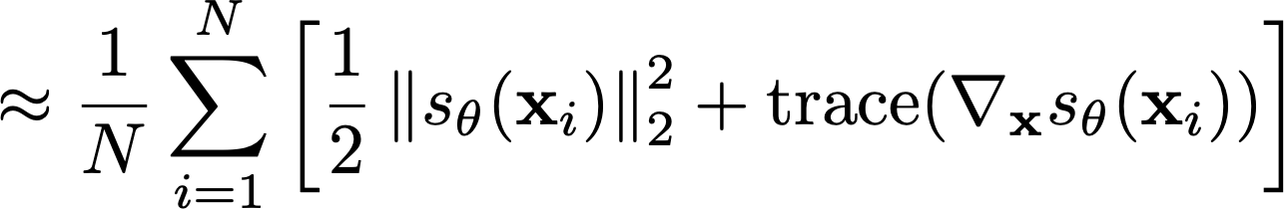
Score Estimation
Given: i.i.d. samples
Task: Estimating the score
Score Model: A trainable vector-valued function
Objective: How to compare two vector fields of scores?
Integration by parts
?
(Fisher divergence)
Average
Euclidean distance
over the space
Score Matching
Hyvärinen (2005)
Notes:
How can we estimate scores from data samples? This is the task of score estimation.
Formally, we are given i.i.d samples x1, x2, to xN from p_data. The task to estimate the score function. We propose a score model, which is a trainable vector-valued function that approximates the data score.
In order to train our score model, we need an objective function to measure the difference between the model score and data score.
Suppose we have the vector field of scores of p_data, and the scores from our model. Consider the data score and model score evaluated at each point in the space. We can compute the Eucledian difference at each point, and average them to measure the difference between model score and data score.
We can summarize the intuition as the following objective, which is the expected Eucledian distance between data and model scores over the data distribution. This objective is known as the Fisher divergence. However, we do not know the ground-truth data score, and Fisher divergence is not directly computable. Luckily, we can use integration by parts to eliminate the dependency on data scores, which gives us the following objective that is equivalent to Fisher divergence up to a constant. This objective is known as the score matching objective, and does not depend on unknown quantities such as the data scores.
Given iid samples, the score matching objective can be easily estimated using empirical means.

Slide 6
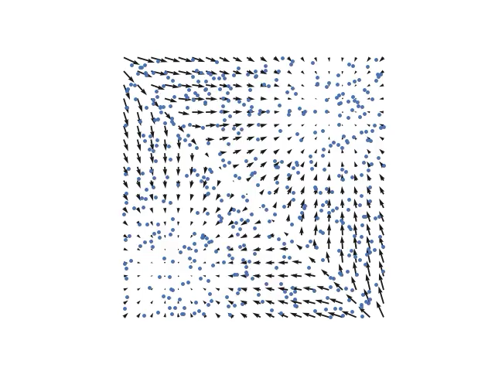
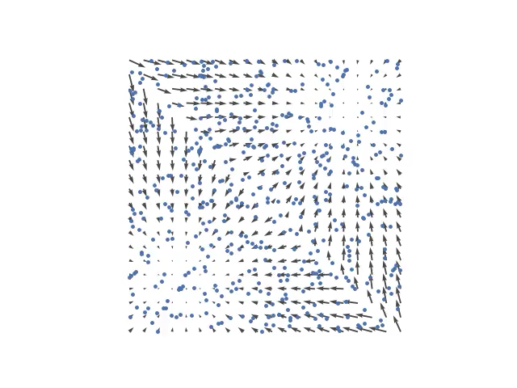
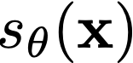
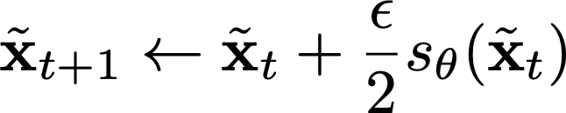
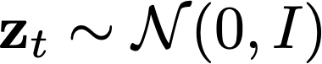
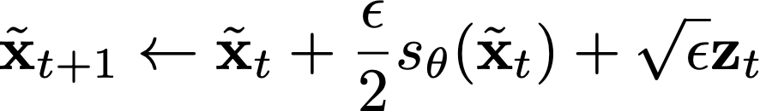
From Scores to Samples: Langevin Dynamics
Scores
Follow the scores
Follow noisy scores:
Langevin dynamics
Notes:
After we learn the score model using score matching, we can define a new generative model if we can directly produce samples from the score model.
How can we do that?
Imagine that we have many random data points in the space. Can we move these random data points close to samples from the distribution? One intuitive approach might be following the vector field of scores to move our random points. However, this will cause all points to collapse to several local attractors.
Instead, there is a procedure called Langevin dynamics where we follow the scores but add a bit Gaussian noise. This is guaranteed to give correct samples under some conditions.

Slide 7


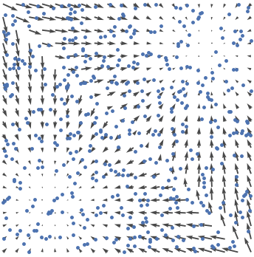


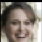

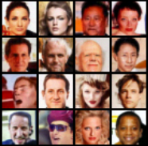

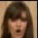


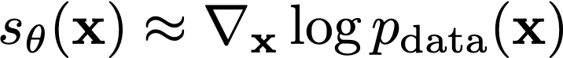
Score-Based Generative Modeling
Score
Matching
Langevin
dynamics
Data samples
Scores
New samples
Notes:
Now we can define a new framework of generative modeling, which we name as score-based generative modeling.
Suppose the only information we know is the iid samples from the data distribution.
Score-based generative modeling works by first estimating the score of data by training a score model using score matching.
Next, score-based generative modeling produces samples with Langevin dynamics, using the score model just learnt. This gives us approximate samples from the data distribution.

Slide 8
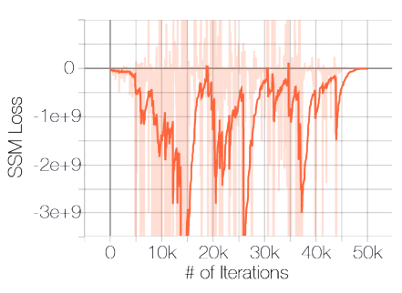
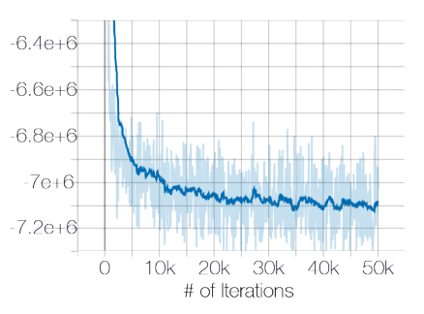
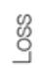
Adding Noise to Data for Well-Defined Scores
Scores can be undefined when
The support of data distribution is on a low-dimensional manifold
The data distribution is discrete
Solution: adding noise
Unstable!
Stable!
Data unperturbed
Data perturbed with
Notes:
Before applying score-based generative modeling to data distributions in the real world, we first need to deal with some complexities.
First, scores can be undefined either when the data distribution is supported on a low-dimensional manifold, or when the data are discrete.
(This slide can be better, a bit confusing)
In both cases, adding noise to data can make scores well-defined. Suppose we add Gaussian noise. The distribution of noise-perturbed data is supported on the whole space, and the perturbed data distribution is continuous.
The following figures show that adding noise is critical to the success of score estimation. On the left, I show the loss curve of training a deep score model on CIFAR-10 images. Without any noise, the curve fails to converge. On the right, I show the loss curve when images are perturbed with small Gaussian noise, in which case the loss curve goes down nicely. The variance of added Gaussian noise is 0.0001, very small compared to the range of pixel values, which is [0, 1].

Slide 9
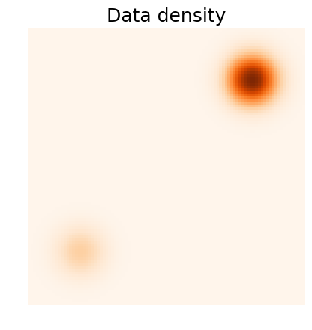
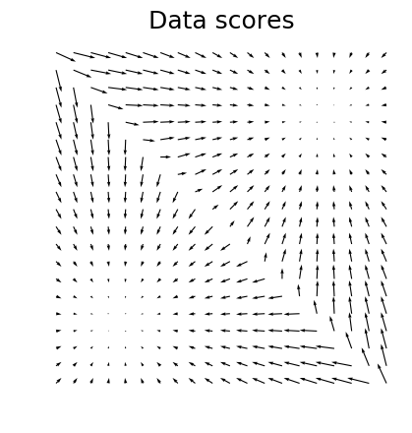
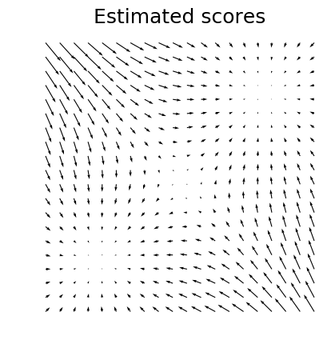

Challenge in Low Data Density Regions
Score estimation is inaccurate in regions of low data density.
Accurate
Accurate
Inaccurate
Inaccurate
Accurate
Accurate
Notes:
Score estimation can also be inaccurate in regions of low data density.
To illustrate this fact, let’s consider a mixture of Gaussian distribution. The left figure is the data density. The middle figure shows ground-truth data scores, while the right figure shows estimated scores.
Comparing middle and right figures, score estimation is only accurate in the highlighted regions, which are those of high data density. For low-data density regions between the two modes, the score estimation is vastly inaccurate.
Why can this happen? Recall that the score estimation objective is equivalent to the Fisher divergence, which is the expected squared distance over the data distribution. When estimated using iid samples, the objective only considers the difference between data and model scores evaluated at data samples.
This can give relatively accurate score estimation in regions that enough data samples are provided. But in regions of low data density where almost no data samples are provided, the estimation can be inaccurate.

Slide 10
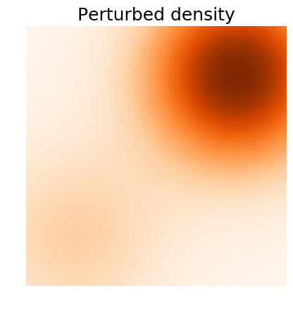
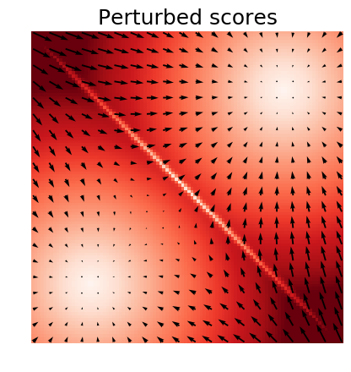
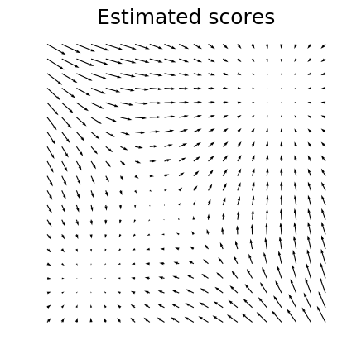
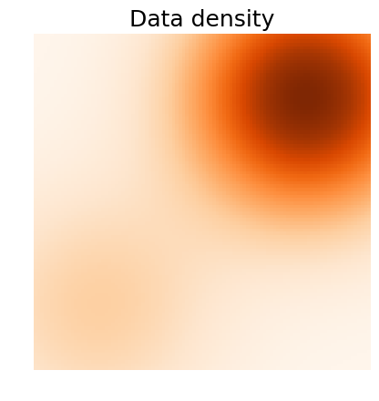
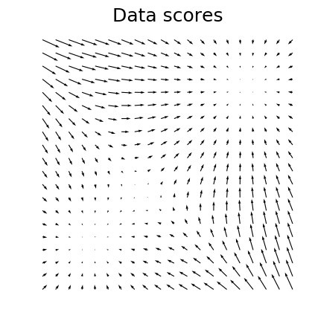
Adding Noise to Data for Better Score Estimation
Random noise provides samples in low data density regions.
Accurate
Accurate
Notes:
Again, this problem can be alleviated by adding noise. When we add large noise to perturb the data, the perturbed distribution can fill the low data density regions and provide samples everywhere to assist score estimation.
From the figures below, it is clear that the score estimation is accurate almost everywhere when perturbed with suitable noise.

Slide 11
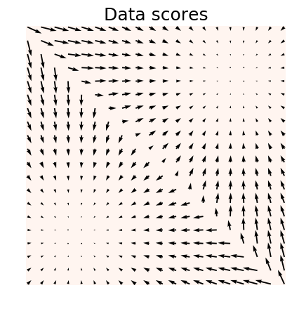
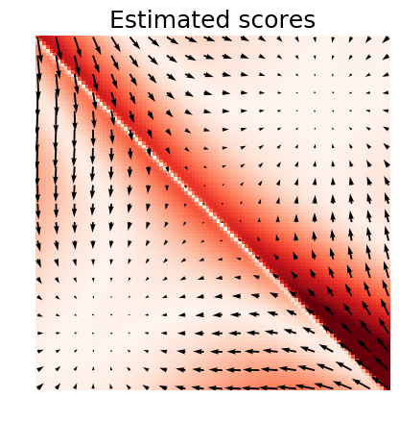
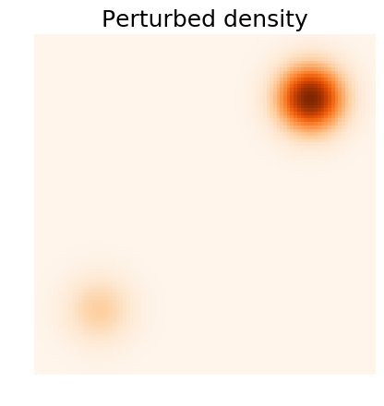
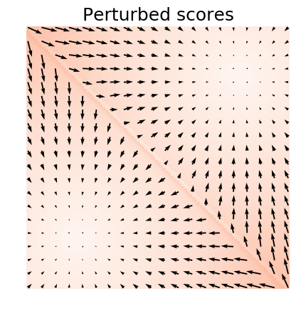
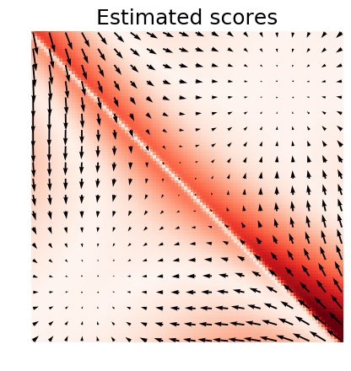
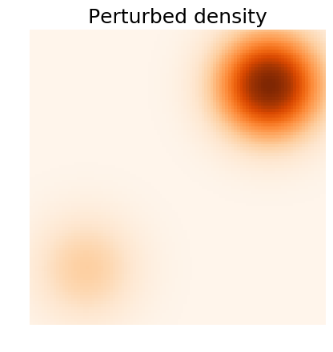
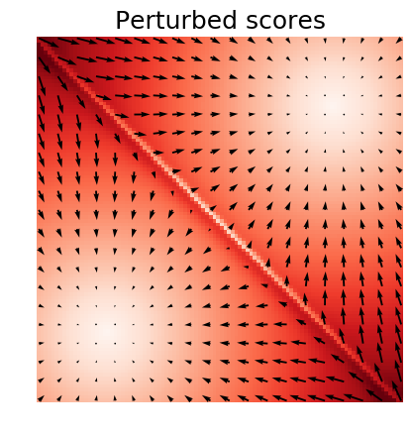
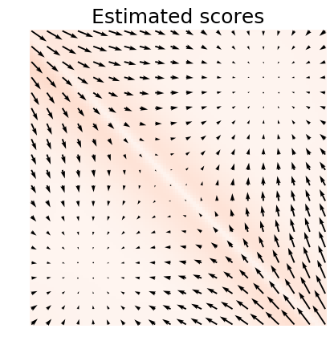
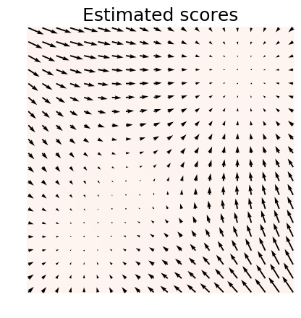
Trading off Sample Quality and Estimation Accuracy
(Red encodes error)
Worse sample quality!
Better score estimation!
Notes:
There is a trade-off between data quality and the accuracy of score estimation when considering how much noise we should add.
Let's return to the mixture of Gaussian distribution. When no noise is added, the ground-truth data score is not affected, but the estimated scores are inaccurate in low data density regions. Here red color in the rightmost figure is to code estimation errors.
Now consider perturbing the data with small noise. The red color in the middle figure codes the difference between the perturbed data score and the orignal data score.
When the noise is small, the perturbed distribution is close to the original distribution, but the estimation errors are still high
When we add larger and larger noise, the estimation error becomes smaller and smaller, but the perturbed data score differs from the original data score by a lot.
In order to achieve the best data quality and estimation accuracy at the same time, we should consider all perturbations jointly instead of focusing on only one perturbation.

Slide 12
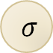


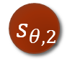
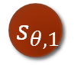
Joint Score Estimation via Noise Conditional Score Networks
$${ x}_{1}$$
$${ s}_{θ,1}$$
$${ x}_{2}$$
$$σ$$
$${ s}_{θ,2}$$
Noise Conditional Score Network
(NCSN)
Notes:
More specifically, for each perturbed data distribution, we can easily sample from them, and use score estimation to estimate the corresponding scores.
However, the most naïve way of doing this requires a large number of separate score models to be learned independently, which is very costly.
We propose instead to use a single conditional score network to estimate the scores jointly for all perturbation levels. The score model will take sigma as an input. This model is named the Noise Conditional Score Network.

Slide 13
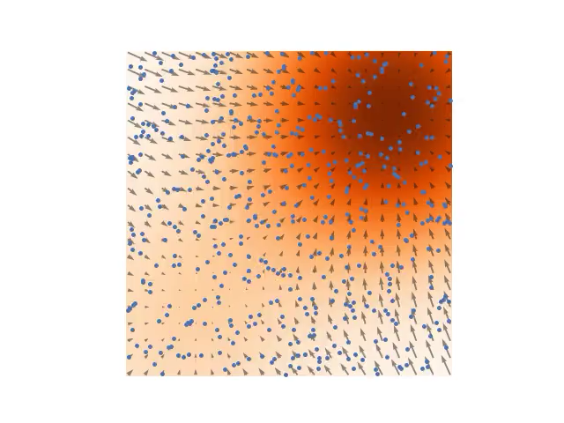







Annealed Langevin Dynamics: Joint Scores to Samples
Sample using sequentially with Langevin dynamics.
Anneal down the noise level.
Samples used as initialization for the next level.
Notes:
How can we sample from the noise conditional score network using scores of different noise levels?
Our method is called annealed Langevin dynamics. We do langevin dynamics for different levels of perturbed data distribution sequentially. We first use Langevin dynamics to sample from the most perturbed data distribution. Then, the resulting samples will be used as initial samples for sampling from the next noise level. We continue in this fashion, and finally use Langevin dynamics to sample from the least perturbed data distribution.
(fix the animation bug)

Slide 14

Experiments: Sampling
Notes:
The following demonstrates the sampling procedure of annealed Langevin dynamics using estimated scores on several image datasets. It is pretty amazing that we can start from random noise, modify the images according to scores, and generate nice looking images.

Slide 15
Experiments: Sample Quality
CIFAR-10 Unconditional
Model | Inception Score (higher is better) | FID score (lower is better)
PixelCNN | 4.60 | 65.93
EBM | 6.02 | 40.58
SNGAN | 8.22 ± 0.05 | 21.7
ProgressiveGAN | 8.80 ± 0.05 | -
NCSN (ours) | 8.87 ± 0.12 | 25.32
Notes:
For the CIFAR-10 dataset, we report the inception score and FID score of samples obtained from our models. We obtain the state-of-the-art inception score for unconditional generation, while the previous best result is obtained by ProgressiveGANs.

Slide 16

Experiments: Inpainting
Notes:
In addition to sampling, our models can also inpaint images with arbitrary occlusions.
Here is a facial image. Here is an image where the right half is missing. We can generate diverse and realistic inpaintings. Same for other facial images as well.

Slide 17
Conclusion
Score-based generative modeling
No need to be normalized / invertible
Flexible architecture choices
No minimax optimization
stable training
a natural measurement of training progress / model comparison
Adding noise and annealing the noise levels are critical
Better or comparable sample quality to GANs.
Notes:
In conclusion,
There are several important advantages of score-based generative modeling.
First, it allows flexible architectures with minimal constraints.
Second, it allows stable and efficient training procedure.
Next, the score matching loss can be used to measure the training progress naturally.
Finally, the score matching losses can be used as a meaningful metric for comparing and selecting different models.
To improve the practical performance of score-based generative modeling, it is critical to perturb data with noise and anneal the noise levels.
Thank you for your attention and see you at our poster session tonight.
Our initial results show that this new method has the potential to outperform GANs in terms of sample quality.
(lacking of latent space)
(Hard to cope with discrete data)

Slide 18
Related Work
Generative Stochastic Networks (Bengio et al. (2013), Alain et al. (2016))
Sampling starts close to data points.
Need MCMC during training with walkback.
Nonequilibrium Thermodynamics (Sohl-Dickstein et al. (2015)), Infusion Training (Bordes et al. (2017)), Variational Walkback (Goyal et al. (2017))
Likelihood-based training.
Need MCMC during training.
Notes:
Of course there are a lot of related work done before us. They are all great work but unfortunately we didn’t have enough time to cover them.

Slide 19
Experiments: Nearest Neighbors

Slide 20
Future Directions
How to apply score-based generative modeling to discrete data?
Theoretical guidance on how to choose noise levels?
Better architecture for higher resolution image generation?
Improved score estimation?

